Slide 1
SQL INJECTION PREVENTION
ALİZE SERRA AÇAR
BETÜL KEKİLLİ

Slide 2
What is an SQL Injection(SQLi)?
SQL injection is a web security vulnerability that allows an attacker to interfere with the queries that an application makes to its database. It generally allows an attacker to view data that they are not normally able to retrieve. This might include data belonging to other users, or any other data that the application itself is able to access. In many cases, an attacker can modify or delete this data, causing persistent changes to the application's content or behavior.

Slide 3
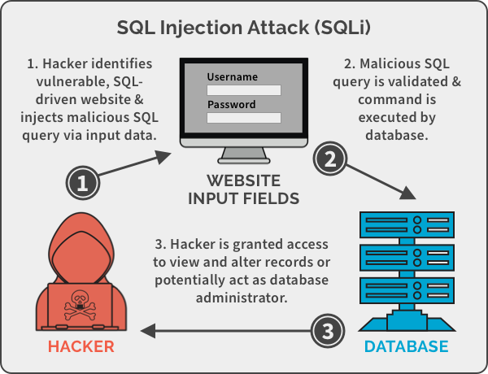

Slide 4
SQL INJECTION TYPES
Retrieving Hidden Data
Subverting Application Logic
Union Attacks
Examining Database
Blind SQL Injection

Slide 5
RetrIevIng hidden Data
An application that displays products in different categories. When user clicks the category, their browser requests the URL:
https://insecure-website.com/products?category=category
This causes the application to make an SQL query to retrieve details of the relevant products from database:
SELECT * FROM products WHERE category = 'Category' AND released = 1
This SQL query asks the database to return:
all details (*)
from the products table
where the category is Gifts
and released is 1
The restriction released = 1 is being used to hide products that are not released. For unreleased products, presumably released = 0.

Slide 6
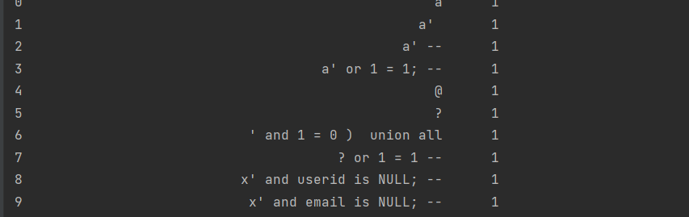
Our datasets first 10 value.

Slide 7

After the first meeting we download the SQLi dataset and working on it. This dataset has 3000 different websites and attacks. Our dataset uses Retrieving Hidden Data type of injection.
We read and preprocessed it. We used Batch Normalization for preprocess.
We have 108. 907 trainable data. We trained data different algorithms and test datas.

Slide 8
Algorithms
Logistic Regression
Random Forest
Support Vector Machines
Naive Bayes
Decision Tree

Slide 9
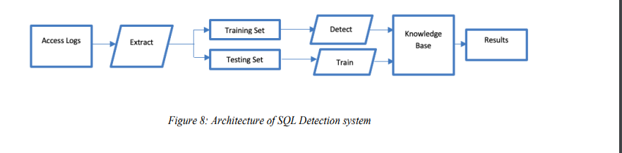

Slide 10
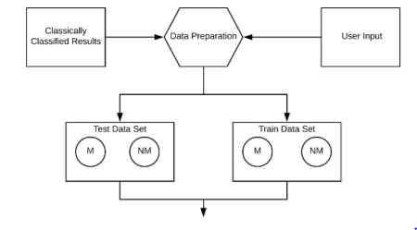

Slide 11
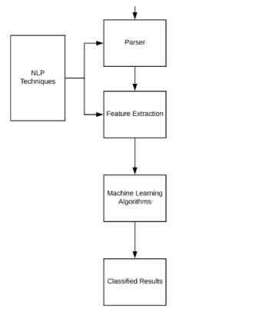

Slide 12
Evaluation MetricS
In each of the algorithms used the :
precision
recall
F1 score
confusion matrix was determined.
Precision: is the ratio of tp to tp + fp where tp represents the number of true positives and fp represents the number of false positives .
Recall: is calculated by the ratio tp to tp + fn, where tp represents the number of true positives and fn represents the number of false negatives.
F1-score: is the weighted harmonic mean of the precision and recall.
Confusion matrix: is defined as a matrix C such that Cij is equal to the observations that are known to be in group i but predicted to be group j .

Slide 13
TESTING VALUES
Algorithm | Accuracy Values
Logistic Regression | 0.9285714285714286
Random Forest | 0.9071428571428571
Support Vector Machines | 0.7642857142857142
Naive Bayes | 0.9773809523809524
Decision Tree | 0.875
Naive bayes has the highest accuracy value for detecting. Why? Because naive bayes calculates the data values between 0-1.

Slide 14
Algorithm | Precision | Recall | F1 Score
Logistic Regresion | 0.90 | 1.0 | 0.85
Naive Bayes | 0.92 | 1.0 | 0.95
Random Forest | 0.86 | 1.0 | 0.87
Support Vector Machines | 1.0 | 0.21 | 0.36
Decision Tree | 0.70 | 1.0 | 0.96

Slide 15
Result
After this processes for our algorithm if the label <0.5 the dataset has no injection but it is higher than 0.5 it has injection. We checked this injections and we created a binary model for detection output.

Slide 16
Thanks For Lıstenıng!!!!!!!!!!!!

